Slide 1
HTML Shorthand Proposal
Program Designers:
Gabriel Woodburn
Ian Waddell
Communications Team:
Robert Knar
Elijah Morishita
Program Testers:
Bradley Owens
Jason Shi
Lyle Reicks
Robert Knar
Skyler Brown

Slide 2
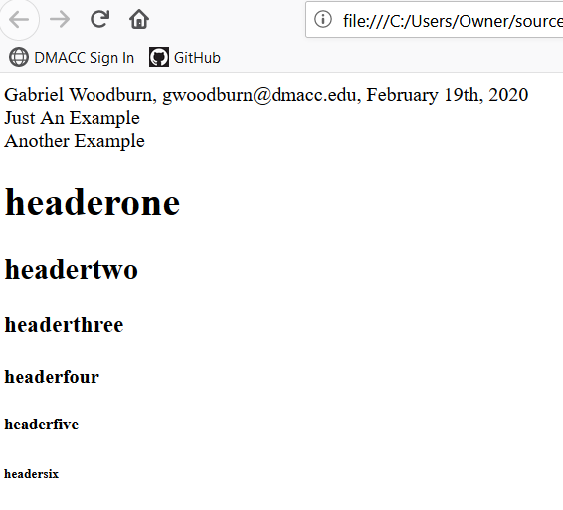
The Purpose:
To create a small, internal program to produce a working html file that our web developers can easily use.

Slide 3
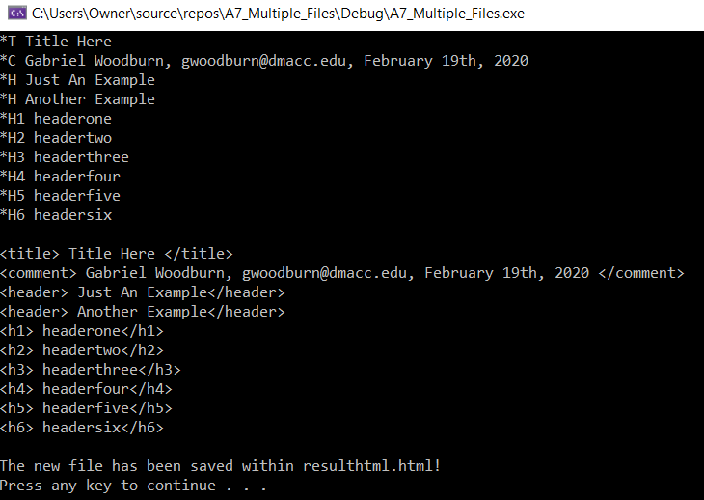
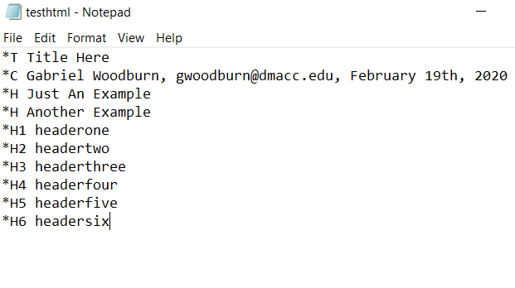
How Does it Work?
Any time one of our developers produces a file, all they have to do is include the key special characters we created in their shorthand.
Our program will compile the information, add the required HTML tags, and produce a working HTML file.

Slide 4
Conclusion
This program will save on both time and cost of continually outsourcing html programmers.

